Slide 1
Description:
1. Attrited Customer / Churned Customer | 2. Existing customers
To find Patterns to predicts why they left the services of banks and to predict which customers are at risk of churning. | By identifying patterns and trends in our data, we can create personalized offers and services that customers, ultimately elevating their satisfaction and potentially attract new customers.
The data-driven approach enables the bank to better understand the factors influencing customer departures and take proactive steps to mitigate such occurrences are tailored to the unique needs of our existing. | To improving customer interactions and offering more relevant services by analyzing credit card usage and financial attributes. This approach increases customer satisfaction and loyalty.

Slide 2
Implementation Flowchart:
Data Analysis
The analysis showed us that the model cannot be trained with the current data set that contains both existing customers and customer attrition.
Thus the solution has been divided into 2 parts to provide more accurate results.
Attrited Customer / Churned Customer
2. Existing customers
1.Data Analysis
2.Featured engineering/ dealing with categorical data.
3. Data cleaning
4. Model Training
5. Predicting customer will churn or not.
1. Data Analysis
2.Featured engineering/ dealing with categorical data..
3.Training the model.
4.Predicting how the customer will use their credits and how banks should improve their customer experience.

Slide 3
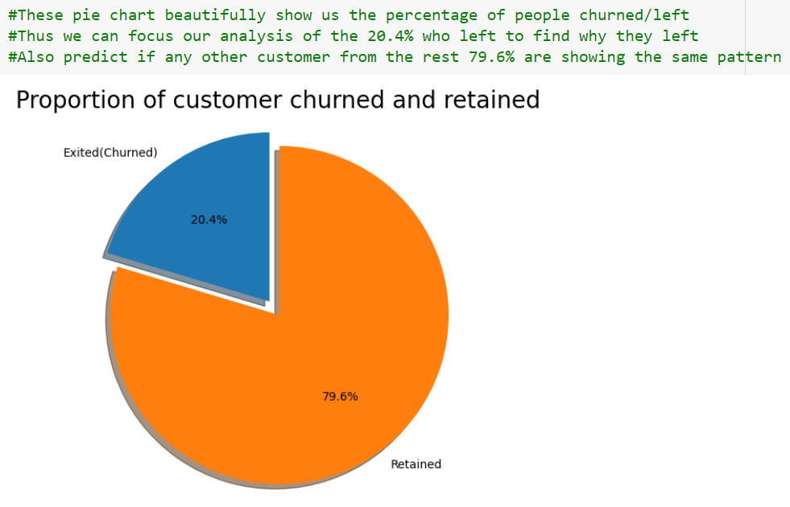
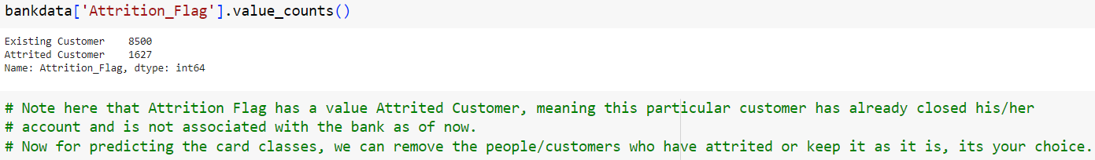
Data Analysis

Slide 4
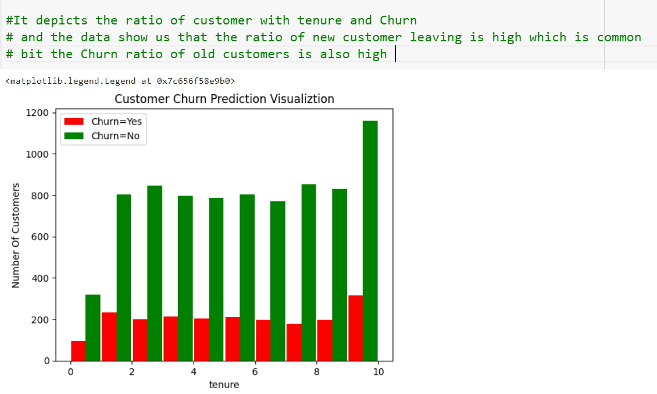
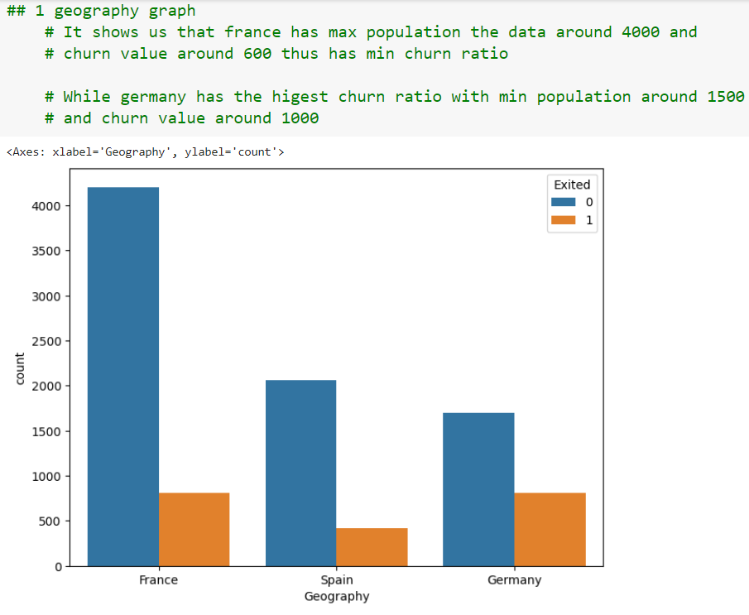
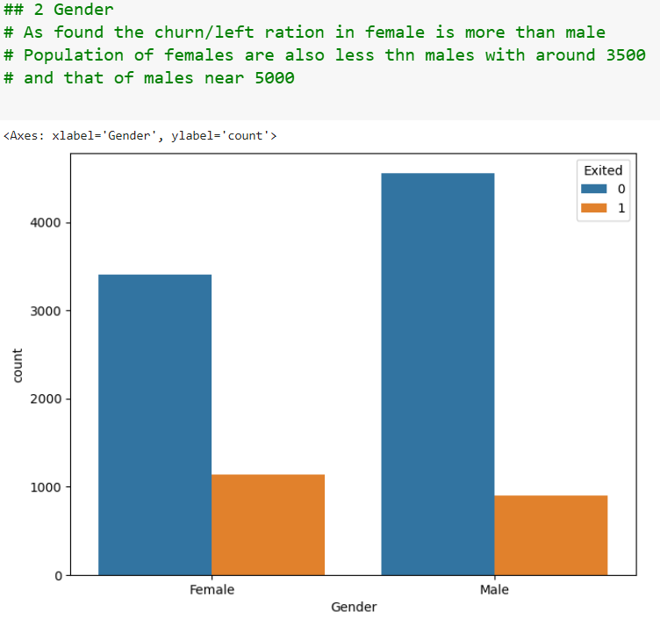
Customer churn:

Slide 5
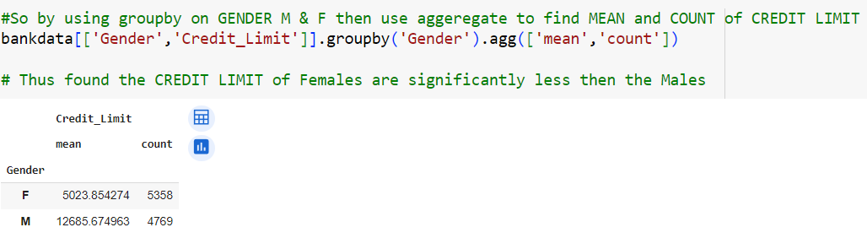
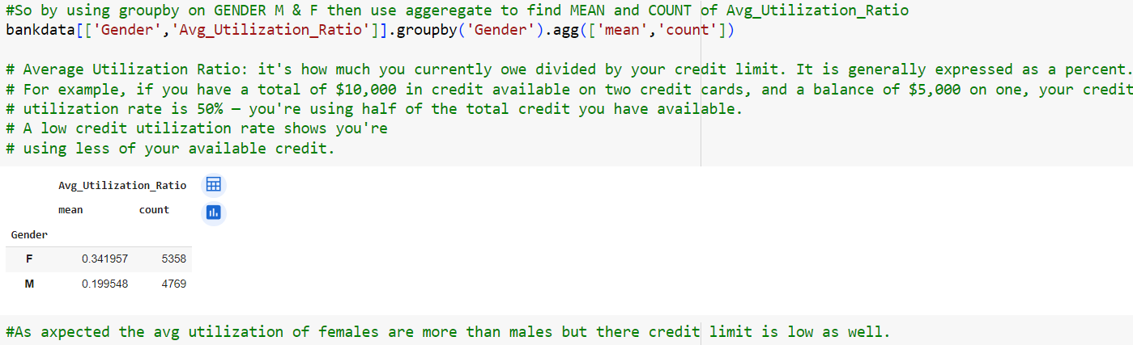
Existing Customers:

Slide 6
